Slide 1

What is ARM?
Advanced RISC Machine
First RISC microprocessor for commercial use
Market-leader for low-power and cost-sensitive embedded applications

Slide 2
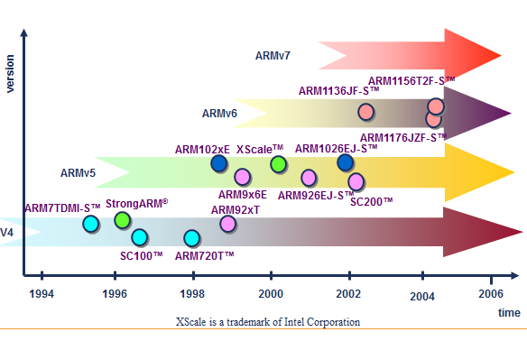
The History of ARM
Developed at Acorn Computers Limited, of Cambridge, England , between 1983 and 1985
Problems with CISC:
    Slower memory parts
    Clock cycles per instruction
Used in:
Handheld devices
High end applications involving complex computation
Robotics
Automation system
Consumer electronics

Slide 3
Fundamentals of ARM :
Load/store architecture
An orthogonal instruction set.
Mostly single-cycle execution.
Enhanced power-saving design.
64 and 32-bit execution states for scalable high performance.
Hardware virtualization support.

Slide 4
Features of ARM :
High performance, low power, small in size (ideal for embedded sys)
Large Register File, Small instruction set, Load-Store instructions
Fixed length instructions, Conditional execution of instructions
High code density, most instructions executable in single cycle
32-bit in-line barrel shifter, built-in circuit for hardware debugging
DSP enhanced instructions, Jazelle (Java byte code extn. 3rd state)

Slide 5
ARM Nomenclature
A R M {x}{ y}{ z} T D M I E J F S (Example: ARM7-TDMI-S)
ARM | Advanced RISC Machine
x | Series
y | MMU ( No. of Memory Management units present)
z | Cache Memory ( in terms of KB)
T | Thumb instructions Support
D | Debugger ( Debugging via JTAG interface)
M | Multiplier
I | In-Circuit Emulator (ICE) macrocell
E | Enhanced Instructions for DSP related applications
J | Jazelle instructions support for JAVA Codes execution
F | Floating-point unit
S | Synthesizable version
Eg. ARM7TDMI
ARM926EJ-S
ARM1136J(F)-S

Slide 6
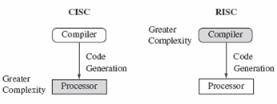
ARM & RISC DESIGN PHILOSOPHY
RISC Processors:
It is a design philosophy aimed at delivering simple but powerful instruction set that executes within a single cycle at high clock speed.
CISC and RISC differ in complexities of their instruction sets where CISC is more complex than RISC.
The smaller instruction set allows a designer to implement a hardwired control unit which runs at a higher clock rate than its equivalent micro sequenced control unit.

Slide 7
RISC | CISC
Simple instruction taking one cycle. | Complex instruction may take one or more clock cycles.
Large register file | Few registers to store data.
Fewer instructions to access memory. | More instructions to access memory
Few addressing modes. | More addressing modes
Instruction Decoder is simple. Hardwired logic is used for the decoder. | The instruction decoder is complex. A decoder using ROM which consists microcode.
Supports pipelining. i.e. overlapping of fetch, decode, execute takes place. | Does not support pipelining.
Fixed instruction size. | Variable instruction size.
Core takes less chip area so more space for cache, MMU. | More chip area is taken by core CPU.
Complexity in software. Compiler design is difficult | Complexity in Hardware. Emphasis is on hardware
Higher clock rates. So faster. | Lower clock rates. So, comparatively slower.
Cache memory is present. | Cache memory is absent or unified cache is present

Slide 8
RISC Philosophy (Four major Rules)
Instructions:Less no of instruction classes to provide simple operations that can execute in a single cycle, each instruction is a fixed length to allow the pipeline to fetch future instructions before decoding the current instruction. (Unlike CISC)
Pipelines:The processing of instructions is broken down into smaller units that can be executed in parallel by pipelines, instructions can be decoded in one pipeline stage.
Registers:RISC machines have a large general-purpose register set & any register can contain either data or an address.
Load-Store Architecture: Processor operates on data held in registers. Separate load and store instructions: transfer data between the register bank and external memory. Because memory accesses are costly.

Slide 9
Pipeline Organization
Increases speed – most instructions executed in single cycle
Versions:
  3-stage (ARM7TDMI and earlier)
  5-stage (ARMS, ARM9TDMI)
  6-stage (ARM10TDMI)

Slide 10
Pipeline Organization
3-stage pipeline: Fetch – Decode - Execute
Three-cycle latency, one instruction per cycle throughput
instruction
i
Fetch
Decode
Execute
i+1
Fetch
Decode
Execute
i+2
Fetch
Decode
Execute
cycle
t
t+1
t+2
t+3
t+4

Slide 11
Pipeline Organization
5-stage pipeline:
Reduces work per cycle => allows higher clock frequency
Separates data and instruction memory => reduction of CPI (average number of clock Cycles Per Instruction)
Stages:
Fetch
Decode
Execute
Buffer/data
Write-back

Slide 12


Pipeline Organization

Slide 13
ARM7 FUNDAMENTALS
All ARM instructions are 32-bit long & stored word aligned.
ARM processor like all RISC processors is a Load Store architecture, Von-Neuman Architecture (same program + data memory).
ARM has two special instructions types for transferring data in & data out of processor.
  Load Instruction = Copy data from memory to registers in the core.
    (Registers in the processor core <----Memory)
  Store Instruction = Copy data from registers to memory
    (Registers in processor core ----> Memory)
There are no data processing instructions that are directly manipulate data in memory (Hence Data processing is carried out only in registers).
ARM core is a 32-bit bit processor most instructions treat the registers ad holding signed or unsigned 32-bit value.
Data Types
Word – 32-bit, Halfword – 16-bit, Byte – 8-bit

Slide 14
ARM7 Features:
3 stage Pipeline (Fetch, Decode, Execute)
Operating frequency: 80 MHz
Power Consumption: 0.06 mW/MHz.
MIPS is 0.97
Available in Von-Neumann Architecture.
Supports both 16- & 32-bit instruction set.

Slide 15
ARM Architecture
Typical RISC architecture:
    Large uniform register file
    Load/store architecture
    Simple addressing modes
    Uniform and fixed-length instruction fields
Enhancements:
    Each instruction controls the ALU and shifter
    Auto-increment and auto-decrement addressing modes
    Multiple Load/Store
    Conditional execution

Slide 16
ARM Architecture
Current low-end ARM core for applications like digital mobile phones
TDMI
  T: Thumb, 16-bit instruction set
  D: on-chip Debug support, enabling the processor to halt in response to a debug request
  M: enhanced Multiplier, yield a full 64-bit result, high performance
  I: Embedded ICE hardware
Von Neumann architecture
3-stage pipeline

Slide 17
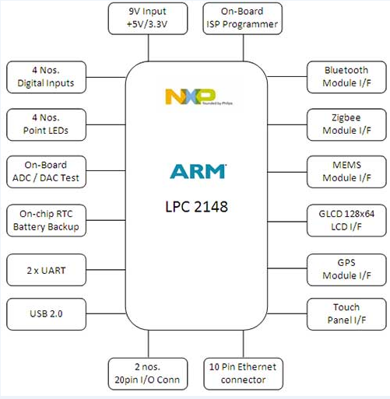
ARM architecture

Slide 18
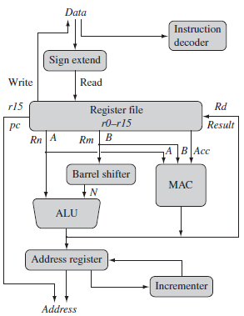
Date Flow Model
When an instruction is decoded inside the ARM core and how a particular instruction is executed by interacting with the internal registers file and then send result out of the registers.

Slide 19
Data Sizes and Instruction Sets
The ARM is a 32-bit architecture.
When used in relation to the ARM:
  Byte means 8 bits
  Half word means 16 bits (two bytes)
  Word means 32 bits (four bytes)
Most ARM’s implement two instruction sets
  32-bit ARM Instruction Set
  16-bit Thumb Instruction Set
Jazelle cores can also execute Java byte code

Slide 20
ARM Registers
31 general-purpose 32-bit registers
Others speed up the exception process
16 Data registers (R0-R15) & one status register (CPSR)
R0 to R13 are orthogonal general-purpose register.
Orthogonal means, any instruction that you can apply to ro can equally be applied to any of the other register.
  Eg. ADD ro, r1, r2
  ADD r5, r6, r7
R13 (stack pointer) and stores the top of the stack in the current processor mode.
R14(LR) Link Register where the core puts the return address on executing a subroutine.
R15(PC) Program counter stores the address of next instruction to be executed.
In ARM state all ARM instruction are 32-bits wide.
In Thumb state all instructions are 16-bit wide.

Slide 21
Operating Modes
Seven operating modes:
  User (Non-Privileged): Only allows read access to the control field in CPSR
  Privileged: Allow full read and write access of CPSR
    System (version 4 and above)
    FIQ
    IRQ
    Abort
    Undefined
    Supervisor
exception modes

Slide 22
Operating Modes
User mode
  Normal program execution mode
  System resources unavailable
  Mode changed
  by exception only
Exception mode
  Entered
  upon exception
  Full access
  to system resources
  Mode changed freely

Slide 23
Processor Modes
The ARM has seven basic operating modes:
  User : unprivileged mode under which most tasks run
  FIQ : entered when a high priority (fast) interrupt is raised
  IRQ : entered when a low priority (normal) interrupt is raised
  Supervisor : entered on reset and when a Software Interrupt instruction is executed
  Abort : used to handle memory access violations
  Undef : used to handle undefined instructions
  System : privileged mode using the same registers as user mode

Slide 24
ARM7 Programmer’s Model or Register Model
System & User
FIQ
Supervisor
Abort
IRQ
Undefined
R0
R0
R0
R0
R0
R0
R1
R1
R1
R1
R1
R1
R2
R2
R2
R2
R2
R2
R3
R3
R3
R3
R3
R3
R4
R4
R4
R4
R4
R4
R5
R5
R5
R5
R5
R5
R6
R6
R6
R6
R6
R6
R7
R7_fiq
R7
R7
R7
R7
R8
R8_fiq
R8
R8
R8
R8
R9
R9_fiq
R9
R9
R9
R9
R10
R10_fiq
R10
R10
R10
R10
R11
R11_fiq
R11
R11
R11
R11
R12
R12_fiq
R12
R12
R12
R12
R13
R13_fiq
R13_svc
R13_abt
R13_irq
R13_und
R14
R14_fiq
R14_svc
R14_abt
R14_irq
R14_und
R15 (PC)
R15 (PC)
R15 (PC)
R15 (PC)
R15 (PC)
R15 (PC)
CPSR
CPSR
CPSR
CPSR
CPSR
CPSR
SPSR_fiq
SPSR_svc
SPSR_abt
SPSR_irq
SPSR_und

Slide 25
In total 17(Visible)+20(Banked Rrgisters)=37
The active registers available in the user mode are shown below.
This is protected mode which is normally used while executing applications.
16 Data registers & one status register
r0 to r13 are orthogonal general purpose register.
Orthogonal means, any instruction that you can apply to ro can equally be applied to any of the other register.
  Eg. ADD ro, r1, r2
  ADD r5, r6, r7
R13 (stack pointer) and stores the top of the stack in the current processor mode.
R14(LR) Link Register where the core puts the return address on executing a subroutine.
R15(PC) Program counter stores the address of next instruction to be executed.
In ARM state all ARM instruction are 32-bits wide.
In Thumb state all instructions are 16-bit wide.
In ARM state Instruction have to be four byte aligned in the memory. Which implies that the bottom two bits of the PC are always zero(Memory location 1000H,1004,1008H).

Slide 26
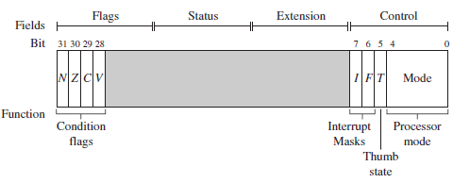
CPSR
CURRENT PROCESSOR STATUS REGISTER
ARM core uses CPSR to monitor & control internal operations.

Slide 27
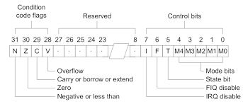
CPSR fields is divided in to four fields,
each 8-bits wide: flags, status, extension, and control.
In some ARM processor cores have extra bits allocated J bit (available only on Jazelle enabled processing which execute 8-bit instructions).

Slide 28
Flag bit | Sets when
N- Negative | In case of signed no. operations If result MSB=1 ;Indicates the result of operation is NEGATIVE
Z- Zero | The result of operation is zero
C- Carry | The result causes an unsigned carry(carry out of MSB)
V-Overflow | The result causes a signed overflow
Q- Saturation | The result causes an overflow or saturation
I- Interrupt request Disable | If set interrupt request channel is disabled
F- Fast interrupt request Disable | If set fast interrupt request channel is disabled
J- Jazelle instruction set | If set processor will execute Jazelle instructions
T-Thumb instruction set | If set processor will execute Thumb Instruction set

Slide 29
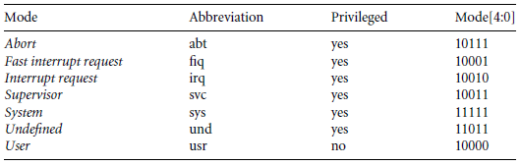
PROCESSOR MODES

Slide 30
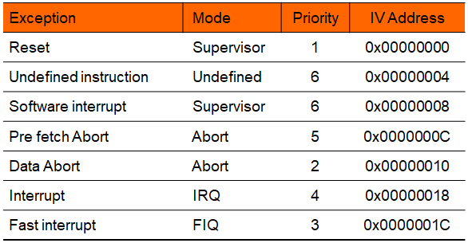
Exceptions
Exception types, sorted by Interrupt Vector addresses

Slide 31
ARM Instruction Set
ARM instruction set
Data processing
instructions
Data transfer
instructions
Block transfer
instructions
Branching instructions
Multiply instructions
Software interrupt
instructions

Slide 32
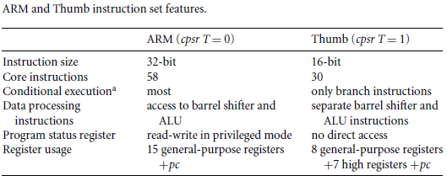
ARM vs THUMB MODE

Slide 33
ARM – QUESTION BANK
ARM- features/fundamentals.
ARM & RISC DESIGN PHILOSOPHY
RISC VS CISC
PIPELINE
ARM – DATA FLOW MODEL
ARM –REGISTERS
ARM – PROCESSOR MODES
ARM7 Programmer’s Model or Register Model
CURRENT PROCESSOR STATUS REGISTER (CPSR)
ARM vs THUMB MODE
Describe about ARM Processors & mention the Popular ARM Architectures in detail?

Slide 34
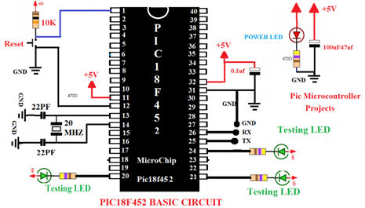
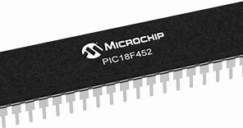
PIC (Peripheral Interface Controller) Microcontrollers

Slide 35
PIC Microcontroller
PIC microcontroller was developed in the year 1993 by microchip technology.
The term PIC stands for Peripheral Interface Controller. Initially this was developed for supporting PDP(programmed data processor) computers to control its peripheral devices, and therefore, named as a peripheral interface device.

Slide 36
Features of the PIC18 microcontroller
- 8-bit CPU
- 2 MB program memory space
- 256 bytes to 1KB of data EEPROM
- Up to 3968 bytes of on-chip SRAM
- 4 KB to 128KB flash program memory
- Sophisticated timer functions that include: input capture, output compare,
PWM, real-time interrupt, and watchdog timer
- Serial communication interfaces: SCI, SPI, I2C, and CAN
- Background debug mode (BDM)
- 10-bit A/D converter
- Memory protection capability
- Instruction pipelining
- Operates at up to 40 MHz crystal oscillator

Slide 37
Architecture of PIC18F Microcontrollers
Microcontroller Unit (MCU)
  Microprocessor unit (MPU)
  Harvard Architecture
    Program memory for instructions
    Data memory for data
  I/O ports
  Support devices such as timers

Slide 38
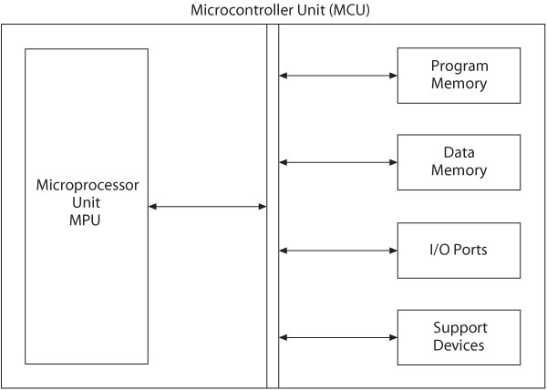
Microcontroller with the Harvard Architecture

Slide 39
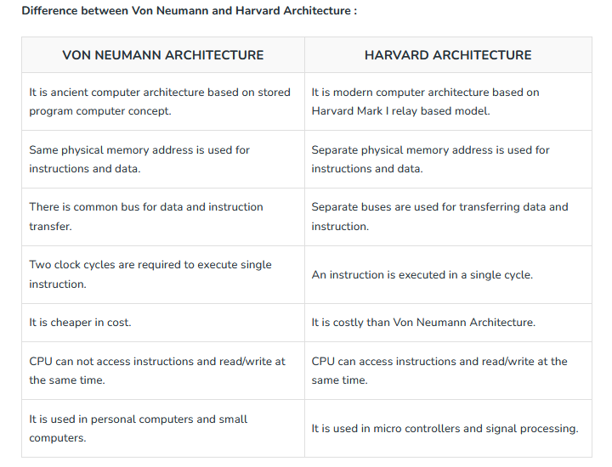

Slide 40
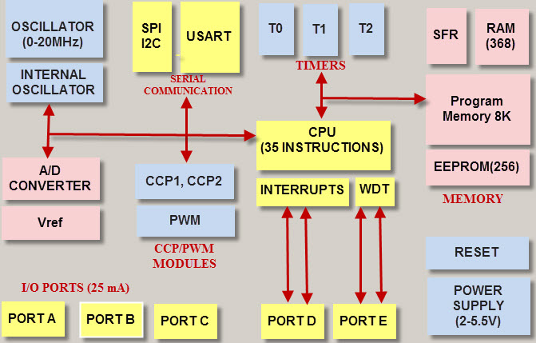
Architecture of PIC Microcontroller

Slide 41
Microprocessor Unit
Includes Arithmetic Logic Unit (ALU), Registers, and Control Unit
  Arithmetic Logic Unit (ALU)
    Instruction decoder
      16-bit instructions
    Status register that stores flags
      5-bits
    WREG – working register
      8-bit accumulator

Slide 42
Microprocessor Unit
  Registers
    Program Counter (PC)
      21-bit register that holds the Program Memory address
    Bank Select Register (BSR)
      4-bit register used in direct addressing the Data Memory
    File Select Registers (FSRs)
      12-bit registers used as memory pointers in indirect addressing Data Memory
  Control unit
    Provides timing and control signals
      Read and Write operations

Slide 43
PIC18F - Address Buses
Address bus
  21-bit address bus for Program Memory
    Addressing capacity: 2 MB
  12-bit address bus for Data Memory
    Addressing capacity: 4 KB

Slide 44
Data Bus and Control Signals
Data bus
  16-bit instruction/data bus for Program Memory
  8-bit data bus for Data Memory
Control signals
  Read and Write

Slide 45
The PIC18 Memory Organization
Data Memory and Program Memory are separated
- Separation of data memory and program memory makes possible the
simultaneous access of data and instruction.
- Data memory are used as general-purpose registers or special function registers
- On-chip Data EEPROM are provided in some PIC18 MCUs

Slide 46
PIC18F452/4520 Memory
Program Memory: 32 K
  Address range: 000000 to 007FFF_{H}
Data Memory: 4 K
  Address range: 000 to FFF_{H}
Data EEPROM
  Not part of the data memory space
  Addressed through special function registers

Slide 47
PIC MICROCONTROLLER – QUESTION BANK
PIC- features/fundamentals.
VONNEUMANN & HARVARD ARCHITECTURE
PIC SPECIFICATIONS (MEMORY, SIGNALS, PROCESSOR UNITS etc;)

